Slide 1
Cat-Tastic Case Study
Athena Stanley

Slide 2
Table of Contents
Introduction
Overview
Problem Definition
Users & Audience
Roles & Responsibilities
Scope & Constraints
Process
Market Research & Competitive Analysis
User Research & Interviews
Ideation
Prototyping
Iteration
Outcomes
Results
Challenges
Lessons Learned
Opportunities

Slide 3
Introduction
Overview
Problem Definition
Users & Audience
Roles & Responsibilities
Scope & Constraints

Slide 4
Overview
New social media app, Cat-tastic, was experiencing issues getting users to complete their signup process. After conducting consumer research and competitive analysis, our team streamlined the process into one requiring less personal information, fewer clicks, and options for dual factor authentication.

Slide 5
Problem Definition
Across all social media platforms users collectively visit the signup landing page of new social media app, Cat-tastic, around 2k times a day, but only 30% complete signup. They are in need of a quick, competitive sign-up flow for their up-and-coming mobile app to encourage users to complete the signup process.

Slide 6


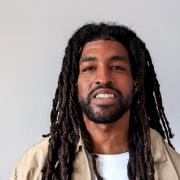

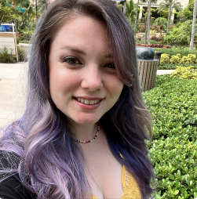
Our Team
Athena Stanley
Brian Littrell
Chauncey Harlan
Rekkai Steed
Robyn Kaufman

Slide 7

Users and Audience
Our average user is a Millennial who uses mobile apps on a daily basis.
They won’t complete the sign-up process for an app that asks for too much information.
They are on-the-go and need a quick, easy way to sign up and sign in without having to use much time or effort.
Oh, and most importantly, they LOVE cats.

Slide 8
Scope and Constraints
Our project was a fairly simple one, but time was certainly something we wish we would’ve had more of. We conducted the majority of our interviews through surveys and didn’t have much of an opportunity to view social media users in their daily environment. We also experienced a bit of a learning curve with Figma, but were still able to put together a product we’re rather proud of.

Slide 9
Process
Market Research & Competitive Analysis
User Research & Interviews
Ideation
Prototyping
Affinity & Usability Testing
Iteration

Slide 10
Market Research & Competitive Analysis
Who else has this problem? A cat-centered social site I found online seemed to be one of the worst offenders. It put first and last name in two different fields, then asked for a nickname, repetition of the password, and a few other things. The sign-up flow took up the entire page and more. We also noticed a lot of sites (even the popular ones) asking for users to enter their birthdate (Facebook and IG, but not Twitter), and popular photo/forum site, Reddit, asked users to create an avatar and username upon sign-up (although it did have them listed as an optional move).
What other solutions are out there? Every website seems to do things slightly differently, but the most successful social media apps seem to have a sign-up flow that requires little more than name, email address, and an email to confirm. They also often give users the ability to sign up using quick links. Some sites (Facebook comes to mind) even have their buttons for sign-up and sign-in showing as two different colors.
Who is using them? Facebook, Twitter, and Instagram are all using quick links to facilitate sign-up. Other solutions are listed above.
How are they performing? They are social media giants.
What are their flaws? Many users don’t like being asked their birthday upon sign-up and would like a more visible option for dual factor authentication for security purposes. Several sites (Facebook in particular) also don’t plainly list password requirements. *Where are the opportunities for this solution? If your site doesn’t require much personal information, you can easily get away with an email and address to sign up. Users can choose to enter further personal information at their own leisure.

Slide 11
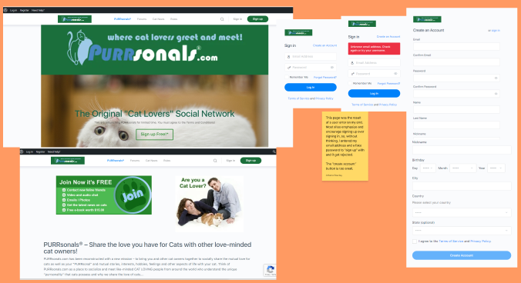
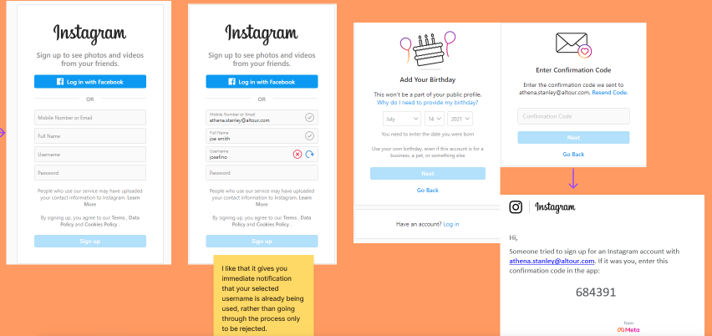

Slide 12
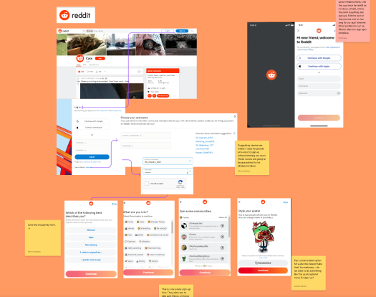
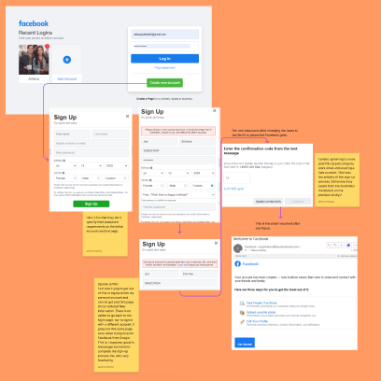
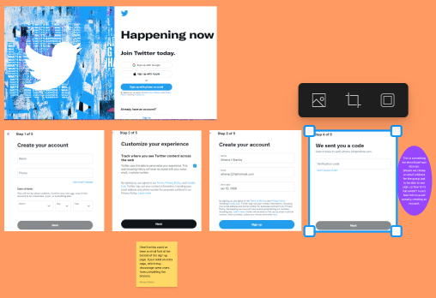

Slide 13
User Research & Interviews
Who did you talk to? We spoke with roughly 50 individuals of varying ages via a survey sent out over social media, then conducted a couple interviews in-person.
Why did you talk to them? We wanted to gain insight into what the average user looks for when signing up for a new app.
What did you learn? People of all age ranges seem to have fairly similar wants and needs when it comes to their ideal app sign-up flow. They also really like quick links to sign up as opposed to using their email/phone number.
What sort of frustrations did they have? They don’t want to have to enter too much personal information.
What was a highlight or striking quote from the interviews? “Just make it quick and easy!” This statement seems to sum it all up. What surprised you most? People don’t seem to like having to create user names. They also seem happier to enter personal information (like their name, phone number, etc.) at a later time if at all possible. And I knew most would probably dislike pop-ups, but they REALLY hate them. I also expected more people to have interest in dual factor authentication.

Slide 14
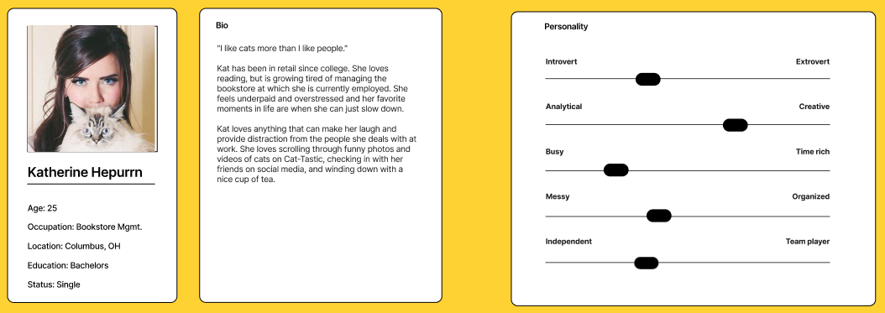
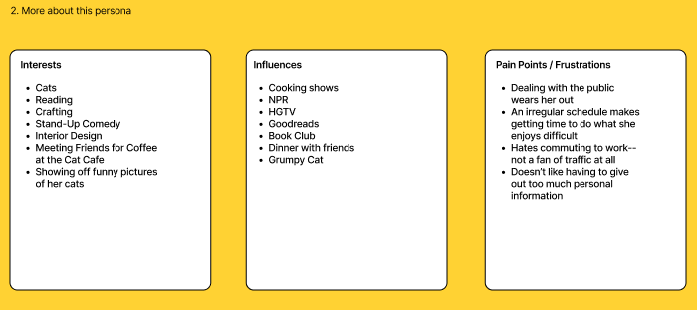
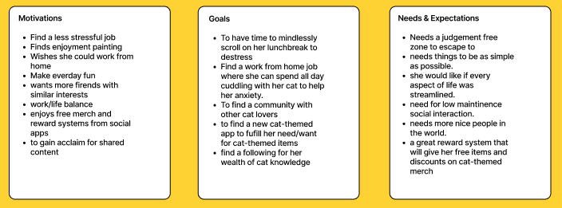

Slide 15
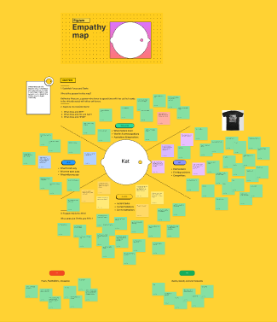
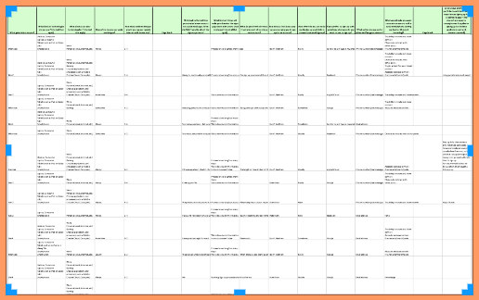
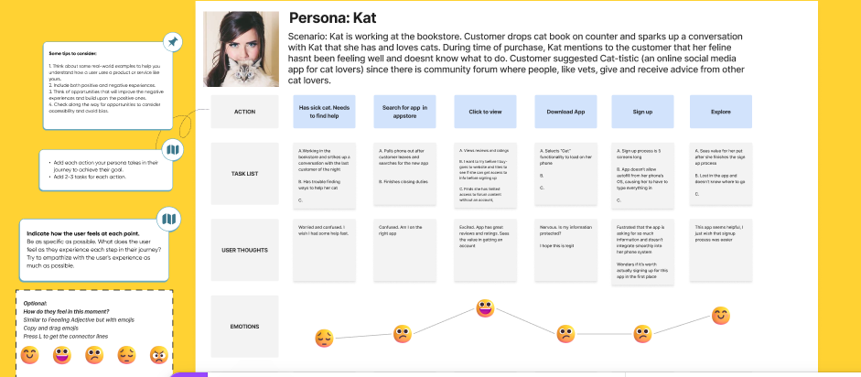
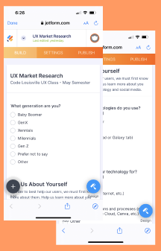

Slide 16
Ideation
What process did you follow to generate ideas? We analyzed our survey and interview research, looked at articles on the subject, discussed our findings, and brainstormed both verbally and via FigJam. We created a chart of problems and potential solutions and then created individual user flow maps as homework.
How many did you come up with? At least a dozen different ideas, probably more.
How did you narrow them down? We debated over Zoom call about which ideas made the most sense. We reviewed each other’s user flow maps and then ultimately decided how to create our own following review. *Which ones did you pick to move forward with? We decided brief was best– sign-up with email, but also give users the option to sign up with Google or Facebook (our most popular from the survey). We also decided to allow users to select dual factor authentication as an optional move.

Slide 17
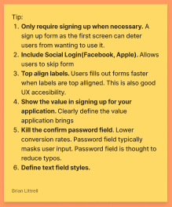
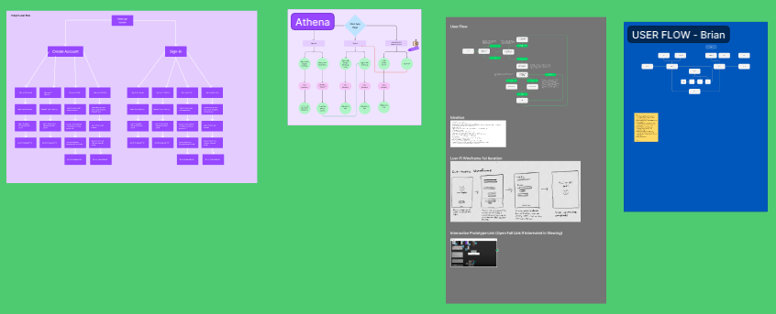
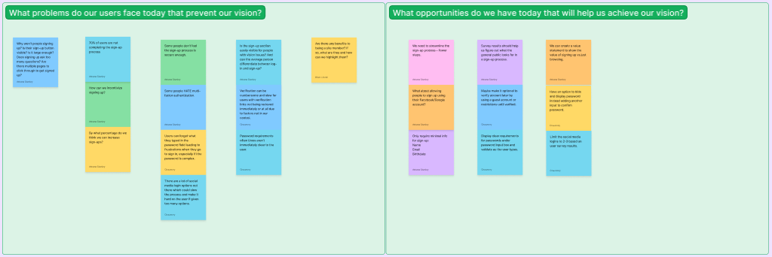

Slide 18
Prototyping
How did you approach making your prototype? I looked over survey data and market research, then brainstormed with my team and put our ideas into one concept.
Did you make wireframes or sketches? I used my user flow as a wireframe, then created a hi-fidelity mockup for the final product.
What challenges did you face while making it? I learned that I do not know Figma as well as I thought I did. I did enjoy the hands-on learning process though.

Slide 19
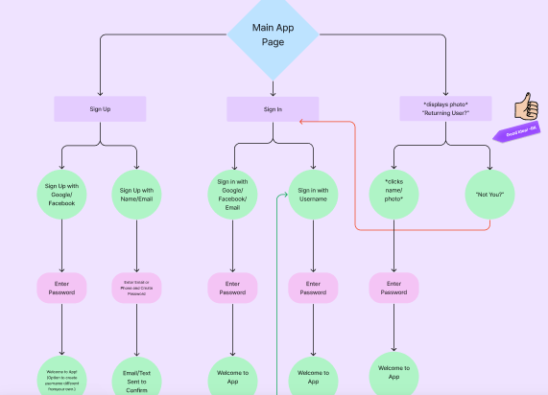

Slide 20
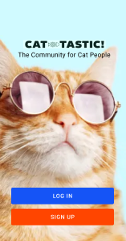
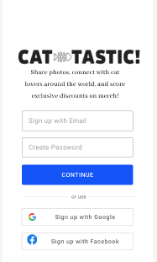
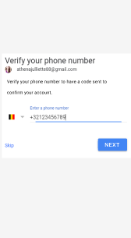
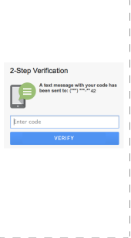
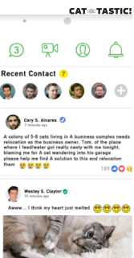
Iteration

Slide 21
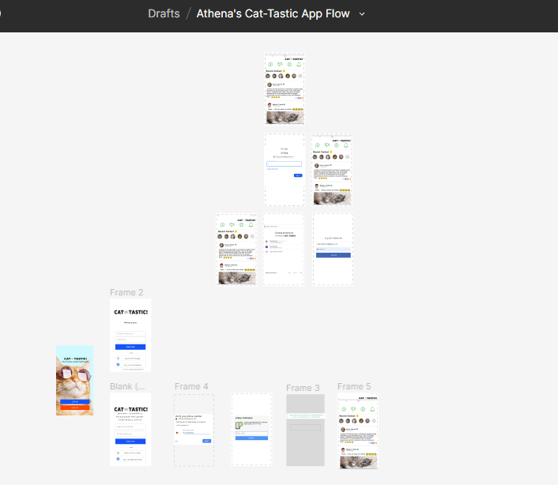
Iteration

Slide 22
Conclusion
Results
Challenges
Lessons Learned 4.Opportunities

Slide 23
Results
With the help of my wonderful team, I was able to create a quick, simple sign-up process for Cat-Tastic. We delivered nearly all of the things our survey respondents requested– email sign-up with the option to use Google or Facebook sign-up, the option for dual factor authentication, and even a brief value statement promising community, content creation ability, and exclusive access to perks.

Slide 24
Challenges
What challenges did you face while creating and testing this solution? Our largest challenge as a group was overcoming issues with time constraints. We also still have A LOT to learn in Figma.
What part was hardest? The learning curve– all the videos in the world can never quite compare with real world experience. I, for example, worked for roughly five hours creating a high fidelity mockup in Figma, only to find my preview link wouldn’t function properly.
How did you overcome it? We worked to set up weekly meeting times that didn’t interfere with our busy schedules, communicated via Slack when we had ideas or concerns, took on the work we felt most comfortable with, and led each other through technological issues as best we could.

Slide 25
Lessons Learned
What did you learn? People want everything to be as simple as possible. Many don’t care about dual factor authentication, but those who do are so impassioned about it that it seems smart to add to apps to retain the trust of clients. And people HATE sign-up pop-ups.
What takeaways would you share with others? Online surveys are a quick, easy way to reach A LOT of people in a short amount of time. *What will you apply in the future? I will try to find more inclusive ways to share my survey outside of social media.

Slide 26
Opportunities
What opportunities are still left in this solution? We would love to have the opportunity to test our app flow with users. And I would love the opportunity to fine tune anything that users may find less than ideal.
What would you do differently, if given the chance? I would’ve given users the option to sign up with their phone number or email, and I may have given them the option to use either of those to receive their code for dual factor authentication. I would also create a flow for forgotten/incorrect passwords and add a statement about password requirements below the password creation box at sign-up.
If you were moving forward with another iteration, what direction would you take? I would love to observe users in a natural environment, with both the apps of competitors and our own app. I would like to work to implement their desires and improve the flow even more. I also want to focus more on accessibility.

Slide 27
Q&A
Thank you for your time.

